Slide 1
Survey data analysis Week 48: “mixed-modes”
© Peter Lugtig

Slide 2
Today
Lecture on survey modes and mixing them
Exercise on measurement
In pairs

Slide 3
Overview
Why and how mix different modes?
TSE and mixed-mode (bonus)?
How do modes differ?
Questionnaire design for single modes
Exercise on questionnaire design
Design
Logistics and mixed mode (bonus)
Evaluation (bonus)
Mixed-device (bonus)

Slide 4
1. Why and how mix modes?
Notes:
4

Slide 5
Why Mixed-Mode?
Choosing the Optimal Data Collection Method!
Best data collection procedure given
Research question
Population
Reduce Total Survey Error (TSE)
Respect survey ethics/privacy
Within available time
Within available budget
See class exercise week 37
Notes:
5
When designing a survey, one wants to find an optimal data collection procedure:
That is the best method given the research question, the population under study and certain restrictions
One typically wants to reduce total survey error and at the same time (read rest of slide)
Last is very important: Available budget. KLIK

Slide 6
We Need to Mix
Increase in International Surveys
Different survey traditions in countries
Different coverage patterns
Different sampling frames
Increase in Online Surveys and desire to exploit new technologies
Coverage problems
Nonresponse increase
Need more effort to increase response
Increase in survey costs
Optimal costs ratio
Measurement
Notes:
Basically we are forced to use it, no other solution or to quote Bill Blyth
The only fitness regime
As I said cross-countries, online

Slide 7
Mixed-mode
Two important distinctions
Different Modes used for Contacting
But data collection in single mode
Different modes used for Data Collection

Slide 8
Mix for Contact
Different contact methods are used in different phases of the survey
Examples:
Screening for special groups by telephone
Sampling frames
E.g. addresses for some, e-mail for others
Convincing or reminding in different mode
Prenotification letter f2f survey
Mail invitation for web survey
Reminder letter/postcards

Slide 9
Multiple Modes of Communication
Nielsen media research
Actual data collection is uni-mode (diaries)
Multiple modes of contact in 7 steps
Pre-recruitment postcard
Recruitment phone call
Advance postcard announcing diary
Diary survey package
Reminder postcard
Reminder phone call
Reminder postcard
Bennett & Trussel, 2001
Trussell & Lavrakas, 2004
Notes:
A very good example of a mixed-mode system is the Nielsen media research methodology (see Bennett and Trussell, 2001; Trussell and Lavrakas, 2004). This mixed-mode system uses an RDD-selected sample of households to which addresses are matched. The mixed mode system consists of seven steps: first a pre-recruitment postcard is mailed to all homes for which addresses are available; this is followed by a recruitment phone call; the third contact attempt is again by mail and is an advance postcard announcing the diary; next the diary survey packet is mailed to all homes for which an address is now available (regardless of the result of the recruitment call). This diary survey packet includes a cover letter, diaries, a cash incentive, a return envelope, and a brochure. A reminder postcard in step 5, a reminder phone call in step 6, and again a reminder postcard in step 7 follow the survey package. Although the actual data collection is uni-mode (diaries), the data collection system is multi-mode with mail and telephone advance notifications and reminders.

Slide 10
Mixing Mode data collection
Different modes for different parts of survey
But all persons get same mode for same part
Example: self-administered mode for section of questionnaire with sensitive questions in interview
Win-win: optimal data quality
Different modes for same task
The same questionnaire is offered in different modes
Risk of differential measurement error
Notes:
A common mix is for instance face-to-face interview with a self-administered questionnaire for sensitive questions.
As long as you do use one method for contacting and another for data collection it is Ok. But mixing within one stage may be dangerous. Will go into this deeper.
First give lots of examples about win-win. E.g. HIV survey with envelop and walking to mail box
Turning computer to respondent in CAPI
Adaption visually impaired. Make noise as interveiwer that you turn your chair.
Audiocasi for illiterate etc

Slide 11
Sequential vs. Concurrent
Concurrent
Multiple modes are used simultaneously for data collection: implemented at same time
Example: Asthma awareness study
Invitation postcard offering choice of modes
Establishment and business surveys (e.g., fax, mail, web)
International surveys
Sequential
Different modes in sequence during data collection phase
Example: American Community Survey
Mail, telephone, face-to-face
Notes:
Now concentrate on data collection phase
Sequential often used to reduce nonresponse, implement next method when first is ‘exhausted’. Discussed this example earlier
Concurrent : both modes are implemented at same time.
A good example is the American lung association survey of asthma awareness among school nurses. In this survey postcards are sent to a random sample inviting them to participate online via an indicated web site or by telephone via a toll free 800 number.

Slide 12
Concurrent Mixed Mode 1
Multiple modes implemented at same time
For subset of questions only
Reduce Social Desirability Bias
Sensitive questions in more ‘private’ mode
CAPI - (A)CASI mix
Telephone - IVR (or T-CASI) mix
Face-to-face – paper SAQ mix
Example: US National Survey on Drug Use and Health (NSDUH)
Win-win situation ☺
Notes:
Concurrent : both modes are implemented at same time.
Case , only part of the questionnaire in different mode
CAPI CASI even integrated programs.
Jos 2005 p. 236-237: One of the most consistent findings in mode comparisons is that self-administered forms of data collection perform better than interview-modes when sensitive questions are asked (for an overview, see De Leeuw, 1992). Therefore, mixed-mode approaches using a paper self-administered form to elicit sensitive information in a face-to-face interview, have been standard good practice for a long time (cf. Turner, Lessler, and Gfoerer, 1992). Methodological studies comparing data quality in computer-assisted forms of data collection also found that the more private computer-assisted self-administered forms led to more accurate reporting of socially undesirable attributes (e.g., Tourangeau and Smith, 1996; Tourangeau, Rasinski, Jobe, Smith, and Pratt, 1997). Therefore the US National Survey on Drug Use and Health (NSDUH) now uses computer-assisted self-interviewing (CASI), where respondents answer the question privately by directly entering the answer in the computer, and only a few non-threatening questions are posed by an interviewer (NSDUH, 2005)

Slide 13
Concurrent Mixed Mode 2
Multiple modes implemented at same time
For all questions, full questionnaire, one population
Reducing Coverage Error at reasonable costs
E.g., Dual frame sampling (more than one frame)
Dangers concurrent mixed-mode
Measurement differences
E.g., social desirability, recency effects
Difficult to entangle as (self-)selection and mode effect are confounded
Reduced coverage error at the price of increased measurement error
Notes:
Concurrent : both modes are implemented at same time.
Case 1, complete questionnaire.
Dual frame sampling, already well known in the 1990-ties telephone surveys
To reduce coverage bias in the early days of telephone surveys, dual frame mixed mode surveys were employed. Coverage bias occurred because part of the population did not have a telephone and the non-telephone households differed from the telephone households on socio-demographic variables such as age and social economic status. A dual frame mixed-mode design has the advantage of the cost savings of telephone interviewing and the increased coverage of area probability sampling: the best affordable method from a coverage-costs point of view. For an in-depth methodological discussion, see Groves and Lepkowski (1985). See JOS 2005 p. 235-36
Offering choice A good example is the American lung association survey of asthma awareness among school nurses. In this survey postcards are sent to a random sample inviting them to participate online via an indicated web site or by telephone via a toll free 800 number.
Note giving a choice is also often cited as good for improving response rate. Not much evidence for this, see Jos 2005 p. 240
Choice what source of error is worse, in web / early telephone days, coverage error was seen as worst. So mixed mode. But still there may be measurement error, caused by different self-selection, web, telephone, were for instance higher educated and measurement visual vs. aural. Only way to get grip is have small mode experiments and use weighting come back to this later

Slide 14
Concurrent Mixed Mode
Coverage
Sampling
Costs
Nonresponse
Nonresponse
Measurement
Measurement
Notes:
Let us go over some special cases. nonresponse example The American Community Survey.
They start with the affordable mail survey and follow-up nonresponse with more costly methods (telephone and finally face-to-face)
to reduce nonresponse and get some information about nonrespondents (to asssess nonresponse error).Nice !
BUT are the data from different methods comparable? May we combine the data? KLIK
Example mail less social desirability. So data that come in later may differ not because they come from other persons,
but because of the data collection method used.

Slide 15
Sequential Mixed Mode 1: Nonresponse Reduction
Different modes implemented in sequence during data collection phase
Successful for nonresponse reduction
Inexpensive mode first main mode
More expensive mode as follow-up
Example: American Community Survey
Mail, telephone, face-to-face
Example: US census
Mail, face-to-face (since 1969)
Example: Canadian Census
Mail/Internet, face-to-face
Notes:
Now concentrate on data collection phase
Sequential often used to reduce nonresponse, implement next method when first is ‘exhausted’. Discussed this example earlier
Concurrent : both modes are implemented at same time.
A good example is the American lung association survey of asthma awareness among school nurses. In this survey postcards are sent to a random sample inviting them to participate online via an indicated web site or by telephone via a toll free 800 number.

Slide 16
Full Example ACS
American Community Survey
Sponsor: U.S. Census Bureau, compulsory survey
Target population: Households in U.S.
2.9M addresses sampled
Focus: social, housing, & economic characteristics
Frame: Census Master Address File
Sequential mixed-mode design:
Mail
CATI Telephone follow-up
CAPI In-person follow-up
Field period: 3 months
Response rates: 80-90% between 2010-2020
Notes:
Example that it works with a lot of effort and money ;-)
2007 AAPOR short course on multimode data collection: design implementation and evaluation

Slide 17
Solution Nonresponse Sequential Mixed Mode
Coverage
Sampling
Costs
Nonresponse
Nonresponse
Measurement
Measurement
Sequential: One method after another
Notes:
Let us go over some special cases. nonresponse example The American Community Survey.
They start with the affordable mail survey and follow-up nonresponse with more costly methods (telephone and finally face-to-face)
to reduce nonresponse and get some information about nonrespondents (to asssess nonresponse error).Nice !
BUT are the data from different methods comparable? May we combine the data? KLIK
Example mail less social desirability. So data that come in later may differ not because they come from other persons,
but because of the data collection method used.

Slide 18
Sequential Mixed Mode 2: Longitudinal Studies
Different modes implemented in sequence at multiple time points in longitudinal study
Cost reduction and practical considerations
More expensive mode
Selection and screening for panel
Base-line study
Next waves less expensive study
Example: Swedish Labour Force Survey
First wave (including recruitment) face-to-face
Next waves: telephone interviews
Example: US Current Population Survey
Face-to-face in wave 1 & 5; Telephone in wave 2-4 & 6-9
Example: NESTOR study, longitidinal survey of elderly
Face-to-face but in between mail surveys
Notes:
Now concentrate on data collection phase
Sequential often used to reduce nonresponse, implement next method when first is ‘exhausted’. Discussed this example earlier
Concurrent : both modes are implemented at same time.
A good example is the American lung association survey of asthma awareness among school nurses. In this survey postcards are sent to a random sample inviting them to participate online via an indicated web site or by telephone via a toll free 800 number.

Slide 19
Sequential Mixed Mode 3: Panels Studies
Online Panels special case
Nonprobaility vs probability based.
To build probability based panels
Sampling frame, probability based sample
First approach & recruitment
Face-to-face, based on household sample
E.g. Liss panel Netherlands
Telephone surveys: RDD
E.g., GESIS panel
Most expensive mode
Selection and screening and recruiting for panel
Recruitment questionnaire + initial data collection
Notes:
Now concentrate on data collection phase

Slide 20
Longitudinal Study Panels Sequential Mixed Mode
Coverage
Sampling
Costs
Nonresponse
Nonresponse
Measurement
Measurement
Longitudinal: Different and expensive first mode!
Notes:
Often panel formation or first wave of longitudinal survey: expensive first mode to avoid low initial response.
If you can identify a main data collection mode in the longitudinal setup: Optimize questionanire to that mode!

Slide 21
In Sum: Common Mixed-Mode Designs
Cross-sectional
Offer two or more modes at same time
To overcome coverage problems
Cross-national
Different countries have different traditions re: main modes
Cross-sectional
Start with cheapest and follow-up with more expensive to reduce nonrespons
Longitudinal mixed-mode or panel
Start with expensive high response mode
Concurrent
Mixed Mode
Sequential
Mixed Mode
Notes:
Go over this again slowly

Slide 22
Literature
De Leeuw, E.D. To mix or not to mix data collection modes in surveys. JOS, 21,2, 2005, pp.233-235. Open Access at JOS http://www.jos.nu/Articles/abstract.asp?article=212233
De Leeuw, E.D., Dillman, D.A., & Hox, J.J. (2008). Mixed mode surveys: When and why. Pp.299-316. In Edith D. de Leeuw, Joop J. Hox, & Don A. Dillman. International Handbook Of Survey Methodology (2008) New York: Lawrence Erlbaum Associates, Taylor & Francis Group, EAM series (European Association of Methodology Series)
Millar M.M. & Dillman, D.A. (2011).Improving response to web and mixed-mode surveys. POQ, 75, 2, 249-269.
Tourangeau, R. Confronting the challenges of household surveys by mixing modes. Keynote at the 3013 Federal Committee at the SMRC
Notes:
Stataistical methodlogy research conference

Slide 23
2. TSE and Mixed-Mode
Skip to: 3. why modes differ
Notes:
23

Slide 24
Implications Mixed Mode in Data Collection Phase
Goal Mixed-Mode Surveys
Reduction of Coverage and Nonresponse Error
Costs reduction
Comparable measurements
Want to have similar data in all modes
Do we reach our goals?
What do we know empirically?

Slide 25
Reducing Coverage Error
Few empirical studies:
Kappelhof: Study of immigrants at Dutch Socio cultural planning office (under review)
Single mode CAPI vs sequential mixed-mode (Web, CATI/CAPI) survey among ethnic minorities
Socio-demographic different respondents participate in different modes
Younger & second generation ethnic minorities more in web
Older, and first generation immigrants CAPI/CATI
But, single mode CAPI best reflection of immigrants

Slide 26
Reducing Coverage Error 2
Second study:
Klausch et al: Statistics Netherlands, general population (conditionally accepted)
Three sequential mixed-mode surveys implemented
First three random groups: telephone, mail, and web. All three were followed by F2F
For socio-demographics the F2F follow up increased overall R-indicators of mail and telephone single-mode response. After the follow up they had representativeness similar to a single-mode F2F survey.
Representativeness of single-mode web was already at the level of single-mode F2F and could not be increased any further by F2F follow-up.

Slide 27
Reducing Coverage Error
Third study:
Messer & Dillman (2011) Washington State University, General population using address-based sampling of paper postal addresses.
Web only exclude important segments of population.
Web plus mail better representation

Slide 28
Reducing Nonresponse
General conclusion:
Danger offer a choice can lower response rates
Do not give a concurrent choice
Fulton & Medway (2012). Meta-analysis of 19 experimental comparisons of concurrent choice option of web in mail surveys
Choice significantly reduces response rates.
However, if you give people their preferred mode (based on answer in first survey), they respond better (Olson et al, 2012).

Slide 29
Why not Offering A Choice?
Concurrent Multiple modes implemented at same time
Usually one mode less costly
E.g., web vs mail, asthma awareness study
Respondent is offered choice of mode
Researcher’s viewpoint
Client centered to reduce nonresponse
Respondent friendly, establish good-will
(and reduce costs)

Slide 30
Respondents Viewpoint: Offering A Choice Makes Life More Difficult
BUT Respondent’s viewpoint is different
More information to read and process
Higher ‘costs’ in social exchange
Increased cognitive burden
Two decisions to make in stead of one
From “will I participate” to “will I participate and what method do I want to use”
Harder task so simplest thing is opt-out
May concentrate on choice, not on survey
Distracts from message and arguments on why to cooperate
Weakens saliency
Respondents postpone, procrastinate, and finally ….
Notes:
Some figures Dillman 2008 in Zeist presentation workshop LISS
Arbitron Radio Diaries (Robin Gentry, 2008) 4-5%
American Community Survey (Deborah Griffin, et al. 2003) - 3-9%
This Survey (Dillman, 2008) - 8-9%
NSF 2003 Earned Doctorate Survey (Grigorian and Hoffer, 2008)- 1-4%

Slide 31
Mixed mode Surveys: Coverage and Nonresponse Reduction
Sequential mixed-mode approach may be more effective than giving respondents a choice
Sequential for nonresponse reduction better than concurrent
Also can be used for coverage problems
If you know the mode preference of respondents (e.g., previous study), giving the preferred mode helps!

Slide 32
Literature
Kappelhof, J.W.S. (under review). Face-to-face or sequential mixed mode surveys among non-western minorities in the Netherlands: The effect of different survey designs on the possibility of nonresponse bias
Klausch, T., Hox, J., & Schouten (2013). Selection error of single- and mixed-mode surveys of the Dutch general population. Conditionally acceptedfor Journal of the Royal Statistical Society: Series A
Messer, B & Dillman, D. (2011). Surveying the general poulation ovr the Internet using address-based sampling and mail contact procedures. POQ, 75, 3, 429-457.
Tourangeau, R. Confronting the challenges of household surveys by mixing modes. Keynote at the 3013 Federal Committee at the SMRC
Notes:
Statistical methodology research conference

Slide 33
Literature
Olson et al. Does giving people their preferred survey mode actually increases participation rates? POQ 76, 4.
Medway, R.L., & Fulton, J. (2012). When More Gets You Less: A Meta-Analysis of the Effect of Concurrent Web Options on Mail Survey Response Rates. Public Opinion Quarterly, 76, 733-746.
Notes:
Stataistical methodlogy research conference

Slide 34
3. Why and How Modes Differ Self-Administered vs. Interviewer-Guided Visual vs. Aural Media-related customs measurement
Skip to: 4. questionnaire design

Slide 35
Why modes differ:
Interviewer Impact
Face-to-face>Telephone>S.A.Q
Media-related Factors
Social customs differ
Knowledge, use
Information Transmission
Presentation stimuli
Aural vs visual
Notes:
More schematically: From literature factors that differentiate between modes. These can be grouped in three classes
Remember ESS experimet interveiwer impact, and information transmission (show card)
Refer to answers given by participants course too

Slide 36
Interviewer Impact +
Self-Administered vs. Interviewer guided
Interviewer administered questions help to:
Motivate respondent
Guide through complex questionnaire
Facilitate Question-Answer process
Clarify questions, instructions
Probe for detailed answers
Accurate recording
Trained interviewer notes down answers
Face-to-face interviewer has more cues and opportunities than telephone interviewer
Nonverbal, visual
Notes:
Motivate, avoid break-offs, (problem in web) partially answered questionnaires
Complexity only for mail surveys, web & CASI computer takes over
Clarify, probe etc, less potential for misunderstandings, easier to ask open questions.
Mail and web only stated instructions in questionnaire and letter, plus some graphical tools (e,g., shading, arrows to help navigation)

Slide 37
Self-Administered +/-
Interviewer absence helps to:
Ensure privacy
Makes interview respondent-paced instead of interviewer- paced (media related)
Conduct survey at time and place convenient to respondent
Interviewer absence limits:
Ensuring that intended (correct) respondent completes survey
Requesting assistance by respondent
Correct stray/out-of-range responses (PAPI only)
Means to assess cognitive engagement of respondent
Notes:
Partly based on frankel & link, who based it on me and Don

Slide 38
How Modes Differ Overviews: De Leeuw 1992, 2005; Dillman & Christian, 2005
Empirical Evidence Interviewer Impact
More social-desirability in interview
E.g., drinking, fraud
More open in self-administered modes
More positive in interview
Less lonely, better health in interview
More acquiescence in interview
Tendency to agree
Easier to agree than disagree with another person
Less missing data/more detailed answers open questions in interview
In general interviewer probes help
Notes:
For overviews see for instance De Leeuw 1992 meta-analysis, see also De Leeuw 2005 JOS and Dillman & Christian Field Methods 2005
Solid facts, much research
This is general for all interviewers. In those cases a SAQ is better be it paper or (A)CASI or Internet.
Also note person of interviewer only with special questions, e.g. race with race related questions, gender with gender related topics
In general meta-analysis, less missing data in interview except on sensitive questions
Message if you use interviewers, train them well in probing etc

Slide 39
Social convention/customs
Socio-cultural but influence cognitive processing in question-answer process
Use of medium
Customs, associations, familiarity
Personal conversation, Spam/selling, web-use
Pace/locus of control
Interviewer vs. respondent
Initiative
Single vs. Multi-task oriented
Convey legitimacy, sincerity of purpose
Fears, spam, identity-theft
Notes:
From literature factors that differentiate between modes. These can be grouped in three classes Here Media related
Medium e.g., personal conversation certain rules, forms official status (have to fill in things for government, a stranger phones, selling, unsolicited mail = spam
Phone interviewer initiates, self-administered respondent more in control, more time for processing, but web ‘quicker medium, multitasking, easier to shift from one task to other, may give more superficial processing
Phone and web have more difficulties in conveying sincerity of purpose. Anyone may phone or spam. Interviewer ID, letter, return address etc help convey Also differ in ability to convey sincerity of purpose (has more to do with nonresponse and/or break-of if questions may look a bit ‘weird’
Example: media related factor. Reminders work in paper questionnaires, but not as well in web surveys. Repeated e-mail messages from someone who is not known, can be considered SPAM. Dillman also suggest different timing

Slide 40
Information Transmission
Presentation Stimuli
Visual vs. Aural
Visual may lead to primacy effects, aural to recency effects
Visual more response categories (longer list) possible
Delivering answer
Spoken vs. written vs. typed
Difference in ease dependent on subgroup (e.g. elderly spoken)
Channels of communication
Verbal, nonverbal, paralinguistic
Graphical language
Questionnaire and Segmentation
Question by question vs Blocks of questions (page) at once
Freedom to go back
Notes:
Aural or auditory. Face-to-face interview capacity to also use visual stimuli (show cards) enabling longer list with response categories than phone. But face-to-face interview is in most practical cases aural, interviewer asks question
Written may be inhibited to make grammatical errors, open questions, typing for web ‘chatting etc less important grammar.
Verbal text, nonverbal gestures, expressions to add / convey extra meaning, paralinguistic, tone of voice, humming etcGraphical language can be seen as mixtures of nonverbal ☺ or paralinguistic information. In paper & web this can be partially used to convey
extra meaning, also arrow etc for navigation on paper, see Dillman Visual design ARMS (paper), but also very important Dillman on web design
Question one by one interview vs. whole page (paper) may influence context effects, order effects.

Slide 41
How Modes Differ
Some evidence recency effect in telephone surveys
More often last offered answer category is chosen
Context and order effects less likely in self-administered (paper) than interview
Overview / segmentation
No empirical studies including web surveys, segmentataion depends on implementation (e.g., potential to go back and forth)
Visual presentation & design & quality
Growing body of evidence that respondents use all information including visual cues to decide what answer they are going to report.
Cf Dillman, 2007; Toepoel, 2008
Beware of using pictures in web surveys
Cf Couper et al 2004; Das, 2009
Notes:
Visual vs. Aural mixed results primacy recency effects, some but mixed results see also Dillman & Christian in Field methods
But:When questions are delivered aurally, respondents seem more likely to choose the last response option heard: the recency effect. When questions are presented visually respondents tend to choose the response category presented at the beginning: the primacy effect (Schwarz, Hippler, Deutsch, and Strack, 1985). But in a large number of experiments and using a variety of question structures, Dillman, Brown, Carlson, Carpenter, Lorenz, Mason, Saltiel, and Sangster (1995) found inconsistent evidence for primacy effects in mail and recency effects in telephone surveys. These inconsistent findings could be due to interaction effects; for instance mail surveys will in general produce less social desirable answers, while in telephone surveys recency effects occur and the last options is favoured. When the last response option of a question is also the less social desirable answer, the two mechanisms will counteract each other, resulting in no large overall differences between the methods. De Leeuw JOS 2005 p 246
Context effects Bishop et al in TSM1 book, 1988, visually presented more likely to select first Schwarz et all, 1985, Tourangeau & Rips, & Rasinski, 2000, also Schwarz et al 1991 same or different page paper increases decreases context effect Schwarz et al 1991, could have implications for web surveys (scrollable vs. segmented) op cit Grovers et al survey methodology p. 159 Opportunity for nice experiments here!
Dillman, course Utrecht 2007, work on homepage, Toepoel thesis

Slide 42
4. Questionnaire Design Traditional Designs for Specific Modes
Skip to: 5. questionnaire design

Slide 43
Cognitive stages when answering
Psychological model based on:
Tourangeau, Roger, Lance J. Rips, and Kenneth Rasinski (2000). The Psychology of Survey Response. New York: Cambridge University Press.
The process of reading/hearing the question and answering the question is translated into a ‘stimulus response’ model.
Stimulus = questions
Response = answer

Slide 44
Model of Tourangeau
In between the stimulus and response is the cognitive information processing task.
“Do you think the better has become a better or worse place to live under the presidency of Biden?”
1 2 3 4 5 6 7
a lot a lot
worse better
stimulus
cognition
response

Slide 45
Model of Tourangeau
Four stages of cognitive information processing after reading/hearing question:
Comprehension
Retrieval
Judgment
Reporting
“Do you think the better has become a better or worse place to live under the presidency of Biden?”
1 2 3 4 5 6 7
a lot a lot
worse better

Slide 46
Model of Tourangeau
Respondent is unaware of the model.
The four steps in the cognition phase happen more or less simultaneously in very short time.
The model helps us to understand the process of
questions ⇨ answers
⇨ This helps us to design a questionnaire of high quality.

Slide 47

Model of Tourangeau
Stage 1: Comprehension Respondent interprets the question.
Interpretation can be affected by the clarity of the question, previous questions, respondent's prior knowledge.

Slide 48

Model of Tourangeau
Stage 2: Retrieval The respondent has to retrieve the information from memory.
Retrieval enhancing techniques
Ordering
Priming
Framing
Prompts and probes

Slide 49
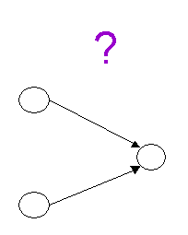
Model of Tourangeau
Stage 3: Judgment Can the retrieved information be used to answer the question?
All different pieces of information result in an internal answer.

Slide 50
Model of Tourangeau
Stage 4: Reporting The final response is a compromise between the internal answer and the response categories.
Judgment maybe changed if no answer category fits the internal answer.
Why differentiate between the internal answer and reported answer?

Slide 51
Model of Tourangeau
Stage 4: Reporting
Final response determined by available response categories and social desirability.
This social desirability bias is especially important when measuring sensitive constructs.

Slide 52
Traditional Design F2F
Face-to-face: Visual + Aural
Show cards with answer choices
Long lists of answers, long scales with each point labelled
Open-ended questions on wide variety of topics
Trained interviewers are carefully instructed to probe in order to get detailed and complete information
No opinion etc not explicitly offered, but accepted when given. Interviewers often trained to accept ‘no answer’ only after a standard ‘probe’
Transitional texts to guide interview
Notes:
Dillman chapter 9 in international handbook, also Dillman & Christian 2005

Slide 53
Traditional Design Tel
Telephone: Aural only
Shorter answer scales (2-5 point scales)
Often only anchored end-points
On a scale from 1 to 5 with 1 being not at all satisfied and 5 being completely satisfied
Visual analogue questions
Imagine a ladder with 7 steps
Imagine a thermometer with a scale from 0 to 100
Unfolding for longer scales
Satisfied, dissatisfied or somewhere in the middle
Completely, mostly, somewhat (dis)satisfied
Notes:
Dillman chapter 9 in international handbook, also Dillman & Christian 2005

Slide 54
Traditional Design Tel2
Telephone design
Difference with face-to-face
In general breaking up questions in parts to accommodate loss of visual channel
Like face-to-face
Open-ended questions and probes
No opinion / no answer not explicitly offered
But is accepted after probe by well-trained interviewer
Notes:
Dillman chapter 9 in international handbook, also Dillman & Christian 2005

Slide 55
Traditional Design Postal Mail Surveys
Mail survey: Visual only, no interviewer present
In general, no breaking up of questions in parts
Use longer list of response categories
Fully labelled scales
Check all that apply instead of yes/no answers
Only ‘no answer’ when person skipped question, in stead of interviewer coded ‘refused, do not know, no opinion’
Go back and forth: more context available
Use illustrations / visuals
Notes:
Dillman & Christian 2005, p 36 Typically mail is the home in which you live (1) owned free & clear, (2) owned with a mortgage, (3) rented (4) occupied under some arrangement. Telephone Do you own or rent a home Do you have a mortgage or is it owned free and clear

Slide 56
Example Traditional Design Mail vs Telephone
Mail
Is the home in which you live:
Owned free & clear
Owned with a mortgage
Rented
Occupied under some arrangement
Telephone
Do you own or rent a home?
Follow-ups accordingly, e.g. when owns a home
Do you have a mortgage or is it owned free and clear
Dillman & Christian, 2005
Notes:
Dillman & Christian 2005, Field Methods p 36 Typically mail is the home in which you live (1) owned free & clear, (2) owned with a mortgage, (3) rented (4) occupied under some arrangement. Telephone Do you own or rent a home Do you have a mortgage or is it owned free and clear

Slide 57
Traditional Design Web
Web survey:
Visual only, but audio/video potential
Many similarities with mail
Differences
More sequential offering of questions
Check all that apply almost standard format
Radio buttons (but…)
Evidence Christian et al (2008) check-all-that apply not optimal
Grids often used for groups of questions
What is best visual design?
Notes:
Perhaps check all that apply is not the best option to use! See Christian Dillman & Smith TSMII, wiley monograph. Dillman will go into this in more detail tomorrow

Slide 58
Traditional Web 2
Also many differences in question design
Special formats
Slider bars
Drop down menus
Open questions influenced by box size, dynamic space (cf Dillman)
Nowadays, mixed device
Mobiles, small screen, no keyboard, touch-entry
Navigation using apps is ‘different’
See bonus slides on mixed-device
Notes:
Web people like drop-down. Personally I hate it, and coming from the Netherlands I now I wondering where the heck is Namubie because the drop-down for countries it is before Netherlands and in a lot of registries I appear to live in the Netherlands Antilles because I click to fast.
Elderly people hate drop-downs for birth date. You have to scroll down and down and down…
Anecdote: usability testing, respondent clicked an earlier birthday, scrolling down made me feel so old….

Slide 59
Visual Illustrations
Visual Illustrations are attractive
May motivate respondent
Cover mail survey positive on response (e.g. Dillman’s work)
Help question/word meaning
BUT: May influence respondent’s answer!!
Example ”How often do you eat out ”
Illustration 1: small table, candlelight, rose in vase
Illustration 2: picture of MacDonald
Visuals/illustrations and their influence (Couper, 2007)

Slide 60
Background Readings
Edith D. de Leeuw (2008) Choosing the method of data collection.
In De Leeuw, Hox & Dillman. International Handbook of Survey Methodology. New York: Lawrence Erlbaum/Psychology Press, Taylor and Francis Group
Edith D. De Leeuw (1992). Data quality in mail, telephone, and face-to-face surveys. Amsterdam: TT-Publikaties. PDF available at http://www.xs4all.nl/~edithl/pubs/disseddl.pdf
Chapter 2: Why expect differences
Chapter 3: Empirical evidence of mode effects: A meta-analysis
Roger Tourangeau, Lance J. Rips, & Kenneth Rasinski (2000). The Psychology of Survey Response, chapter 10. Cambridge: Cambridge University Press
Vera Toepoel (2008). A closer Look at Web questionnaire design. University of Tilburg, CentER Dissertation Series
Notes:
If you want to design optimal mixed-mode studies, and choose intelligently, one has to know how modes differ and why. This is the next topic

Slide 61
Exercise: design for mixed-modes

Slide 62
5. Designing Questionnaires for Mixed-Mode Surveys
Skip to: 6. logistics
Notes:
62

Slide 63
Design For Mix
Two Situations / two major distinctions:
One main method that accommodates the survey situation best
Main method is used to maximum potential
Other methods auxiliary
Example panel formation
Truly multiple mode design
All modes are equally important
Example: International surveys
Example: Concurrent mixed-mode and respondent is offered choice
Notes:
Examples:
One main method, other methods auxiliary
Nonresponse follow-up.
Non-covered groups with additional method
Some longitudinal designs
Calibration studies
Truly multiple mode design: modes equally important
Different countries/municipalities use different mode
Respondents may choose
So Explicitly design for mix. Incorporate this.
Several carefully planned experiments showed small mode effects. Carefully designed to make comparable. Lot of work, lot of control, small scale experiments. Real life survey practice may be quite different! Still positive news is one CAN design for MIXED mode studies to minimize mode effects.
Cf Biemer & Lyberg p 208-210
One main mode: accommodates survey situation best and is all important design factors are taken into consideration Used to its maximal potential with certain constraints e.g. prescribed number of call backs than another mode is used to raise response within costs
Truly mixed-mode, no main mode is identified
Example longitudinal Initial recruitment plus background questions done face-to-face, all next waves done by phone. So recruitment different from all other waves, but all other waves remain the same concerning mode
Do More design for OPTIMAL mix

Slide 64
One Main Method: Other data collection modes auxiliary
Notes:
We discussed the first case one main method and the consequences for design. If you go deeper into questionnaire design for mixed-mode surveys, then there are three different approaches , three philosophies in design. We will discuss these three here

Slide 65
Optimization
One Main Method, other methods auxiliary (cf Biemer&Lyberg 2003)
Identify main method
Use main method optimal and to its maximum potential
Auxiliary methods designed as equivalent as possible
To avoid measurement error
May be perhaps sub-optimal for auxiliary method
Example: less response categories
Note: Dillman et al (2009) coined this ‘mode-enhancement-construction’
Notes:
This situation described in book Biemer-Lyberg 2003 Introduction to survey data quality
It is important to clearly identify what the main method is and design the survey around this main method.
The auxiliary methods are auxiliary! So perhaps they are not used to their full potential, but you want to avoid measurement error.
Sometimes difficult to convince staff responsible for auxiliary methods!
Example main tel, aux face-to-face
Dillamn, Smyth & Melani Christian 2009internet, mail and mixed-mode surveys, the tailored design method, Wiley, page 328

Slide 66
One Main Mode: Use Design for Optimization Mix
Preferred-mode-specific design.
Aka mode-enhancement
Designing a mixed-mode study where one mode is the primary or preferred mode, and other modes are seen as auxiliary. In this design the questionnaire is optimized for the primary mode and the questionnaires for the other (auxiliary) modes are adapted to the optimal design for the main mode.
Glossary International Handbook of Survey Methodology
http://www.xs4all.nl/~edithl/surveyhandbook/CH16%20de%20Leeuw.pdf
Notes:
First situation described in book Biemer-Lyberg 2003 Introduction to survey data quality
This definition comes from mixed mode chapter in LEA book

Slide 67
Example Swedish LFS
Longitudinal face-to-face & telephone
Identify main method
Main method not necessary first method
Main method telephone
Face-to-face auxiliary from longitudinal point of view
Main design for telephone interview
Longitudinal questions perhaps suboptimal from face-to-face interview option
E.g., no visuals, showcards
cf. Biemer & Lyberg, 2003
Notes:
This situation described in book Biemer-Lyberg 2003 Introduction to survey data quality
It is important to clearly identify what the main method is and design the survey around this main method
First wave and recruitment interview face-to-face, but this is not main method
It is important to clearly identify what the main method is and design the survey around this main method
First wave and recruitment interview face-to-face. Use only the full monty for questions that are one time recruitment / background questions.
Use telephone interview as standard for the questions that are used at multiple time points, the longitudinal questions

Slide 68
One Main Method: Cases
Telephone with Face-to-Face Mixes
If telephone main method
Relatively easy to design optimally with a preferred-mode-specific design.
Interviewer assistance in both modes
Do not use the ‘extra’ visual channel in face-to-face
If face-to-face main method
Absence of visuals makes it more complicated
Carefully balance pro and cons
Optimize for one? (preferred-mode specific design, aka mode-enhancement construction)
Or use ‘uni-mode’ design?
Implement a small experiment within one mode if possible!
Example ESS experiment on show card influence
Notes:
This LFS was relatively easy
Other way around more difficult.
If you read a 10-point scale will they get it? Send show cards in advance? Change question to optimize for phone & implement a careful experiment to use for calibration?
Depends on goal if nonresponse follow-up, perhaps any information even information with noise is better than absolute absence of information
But realize that there is noise ☺

Slide 69
One Main Method 2
Self-Administered Questionnaires and Interviewer Mixes
SAQ or Interview Main Method?
Complexity of questionnaire
Big issue in mixes with paper-mail not in mixes with web
Are visuals essential?
Face-to-face in mix may accommodate visuals, phone does not
CAWI-CATI may have problems, CAWI-CAPI not
Sensitive questions
Social desirability differences, interviewer influence
Is interviewer probing essential or not?
Paper mail problems, but web can emulate some probes
Notes:
SAQ main and not many visuals relatively easy.
Again even after careful design implement a careful experiment to use for calibration. If not possible (time & money) then depends on goal
if nonresponse follow-up, perhaps any information even information with noise is better than absolute absence of information
But realize that there is noise ☺

Slide 70
Truly Multiple Mode Surveys: Modes are Equivalent Three Approaches in Design
Notes:
We discussed the first case one main method and the consequences for design. If you go deeper into questionnaire design for mixed-mode surveys, then there are three different approaches , three philosophies in design. We will discuss these three here

Slide 71
Modes Are Equivalent
Three schools of thought:
Mode Specific Design or Method Maximization
Optimize each mode separately
Unified Mode Design or Uni-mode design
Provide the same stimulus (question format) in each mode, same offered stimulus
Generalized Mode Design
Purposively constructing questions to be different to achieve cognitive equivalence, same perceived stimulus
This can be seen as a sophisticated form of mode specific design
Notes:
Go deeper into this later, here just mention the three words
Sometimes in practice compromise Pierzchala disparate modes ( if you can unified, but if not optimize)

Slide 72
I. Mode Specific Design or Method Maximization
Optimize each method individually
If one method has an extra use it
Rationale
Reduces overall error
Best of all possible worlds
Assumption
Same concept is measured in both modes but with different accuracy
Differences between methods only affect random error! (no systematic bias)
E.g. Some, factual items (Tourangeau, 2013)
Notes:
Use the full monty for each method. Best to do error reduction! Method A & B measure the same thing, only difference is random error terms differ in size. Only if difference between modes are random error. How about Question format effects?
May be that one is introducing systematic error (bias). In that case, data integrity is being threatened! Best of possible worlds?
Remember Candide
Tourangeau 2013 Keynote FCSMRC

Slide 73
II. Unified Mode Design
To minimize data integrity problems Dillman (2000) proposes UNI-mode design for all modes
Uni-mode design. From unified or uniform mode design; designing questions and questionnaires to provide the same stimulus in all survey modes in order to reduce differences in the way respondents respond to the survey questions in the different modes.
Write and present questions the same or almost the same
Same offered stimulus in each mode
Notes:
As reaction to this Dillman proposed Uni-mode design.
Dillman 2000 book mail and internet surveys, presents principles for unimode design.
Providing the SAME stimulus Definition mixed mode chapter Erlbaum

Slide 74
Sound Basic Strategy
Uni-Mode (unified) mode construction
Writing and presenting questions the same to ensure respondents receive a common mental stimulus
Same question structure across modes
Same response categories across modes
Dillman, 2000, chapter 6, pp.232-240
Easier for some mixes than for others
Mail & web
Both visual, both self-administered
Helps question presentation, private
Notes:
74

Slide 75
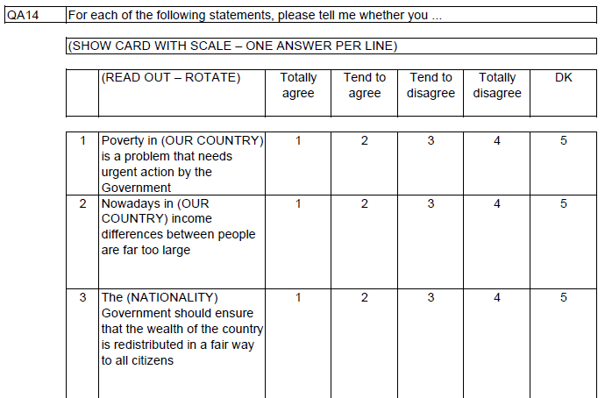
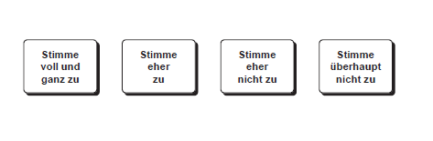
How to write 1
Mix of Web (mail) and face-to-face
Face-to-face can handle show cards (visual)
So longer list of response options possible in mix
Note Interviewer should show question show card!

Slide 76
How to write 2
Mix of Web (mail) and telephone
Telephone not visual, auditive only
Telephone may cause problems with certain questions
Limited number of response categories
Use uniform response scales if possible, thus use as less different response scales as possible (save interview time and respondent-effort)
Design with a special format and use in ALL modes
Yes-no instead of mark all that apply
Endpoint labeling, in stead of full scale, etc

Slide 77
How to write 3
Mix of Web (mail) and interview (ftf/tel)
What to do with ‘do-not-know’
Not offering (implicit) in all modes
Make sure that online respondent can skip questions, like in mail
No forced (mandatory) answer!!!
Offer explicit do-not-know
If interviewer is instructed to probe, then also program in a friendly probe (same wording) online
Mail is problem here (probing not possible)
Notes:
Probing
Experimenst De Leeuw, Hox, & also newer motivational, by bahrad & lynn

Slide 78
Open-ended 1
Open-ended questions are applicable in all modes, but keep in mind some effects:
Modes with interviewer (CATI, CAPI):
Advantage, probing by interviewer
But interviewer writes down the open answers – big filter! Most effects derive due to that.
Potential for social-desirability effects
Easy probe after open question “anything else you want to add?”
Interviewer administered, but also possible in web surveys
Notes:
Reference to oudejans & Christian in das buch

Slide 79

Open-ended 2
Online:
Give good instruction/motivate
If important, add a friendly probe
Usually rich in amount of words comparing with other modes
Check for nonsense and fake answers (like “asdhakshfkjhsadfkh”) before analysis, maybe eliminate people with fake answers
Size of box contains information
Notes:
Ref work Smyth & Dillman etc in POQ
Oudejans & Christian in das buch

Slide 80
III. Generalized Mode Design
From unified (uni) mode design to an integrated, generalized mode design
Generalized mode design.
Purposively constructing questions and questionnaires to be different in different modes with the goal of achieving cognitive equivalence of the perceived stimuli, thereby resulting in equivalent answers across modes.
The same offered stimulus is not necessarily the same perceived stimulus!
Analogous to translation issues: literal versus in context translation
But again burden of proof of equivalence on researcher!
Notes:
Eventueel dit weglaten (leave out! For time purposes)
Skip to 67 immediately!
Uni-mode design Dillman 2000 book mail and internet surveys, presents principles for unimode design.Uni-mode design Dillman 2000 book mail and internet surveys, presents principles for unimode design.
But one can go one step further
Universal same stimulus NOT NECESSARILY Same question.
Comparable with discussion about questionnaire translation. Literal translation vs... translation of concept.
Much more difficult but potentially better (if well done, controlled, etc) see also interviewer behavior conversational vs... scripted. Translate meaning to respondent!
May be controversial, at least Topic of much discussion
Providing the SAME stimulus is not necessarily the SAME PERCEIVED STIMULUS Definition mixed mode chapter Erlbaum

Slide 81
Generalized Mode Design continued
Designer understands
How differences between modes affect the question-answer process
How they affect the way respondents perceive the question, process the information and select and communicate the response
Burden on the researcher to demonstrate that different questions elicit equivalent responses.
Example Pierzchala et al, 2003
CATI: Are you {name}?
Web: Is your name {name}?
Notes:
From mixed mode chapter Erlbaum

Slide 82
6. Logistics & Mixed-Mode
Skip to: 7. evaluation of errors
Notes:
82

Slide 83
Consequences Mixed Mode Strategy
Coverage
Coverage
Costs
Costs
Nonresponse
Nonresponse
Measurement
Measurement
Sampling
Sampling
Logistics
Logistics
Notes:
Could be more complex to estimate sampling error, but complex statistics may solve this
Example telephone RDD which is a SRS, face-to-face may often be a form of cluster sampling and/or stratification
For instance think of Area probability sampling. May solve stat problems with Mplus analysis
If clear list (special populations) with all contact info there may not be any problems as SRS may be done for both modes
By mixing less expensive with more expensive methods costs are higher than staying with less expensive method, but they remain reasonable (affordable while using solely expensive method is not affordable)
Measurement: mode effects may be a real problem for measurement, but we are learning how to design optimally for mixed-mode. Still much research needed.
One thing we can be sure of is that doing a mixed mode study will make the logistics more complicated

Slide 84
Main Issues
In-House Expertise
Communication
Implementation and Timing
Data Processing
Quality Control
Paradata information
Cost
Many of these issues well-known in International and Comparative Research
See for example CSDI International Workshop on Comparative Survey Design and Implementation &Cross-cultural survey guidelines at http://ccsg.isr.umich.edu/

Slide 85
Risk
“Risk of errors, delays, and increased costs arising from the duplication of efforts or additional work inherent in conducting research across different modes” Macer 2003
How to avoid /limit
Coping with operational complexity
Notes:
Should accept increased costs but not sky high, how to limit
Should not accept delays or errors!

Slide 86
Operational Complexity
Different recruitment and screening strategies
Designed, programmed, tested
Integration needed
Survey instrument
Designing and programming
Duplication or integrated software
Data handling
Ideal relational data base
Practice mixed-mode puts penalty during data analysis: reformatting disparate data files
To meet needs of operational complexity…..
Notes:
Risks of delays and errors caused by operational complexity
What are these (based on macer,2003) recruitment and screening see winer for a neat integration telephone interviewers for helpdesk and reminding
Software developed for CATI/CAWI see for instance overviews of Macer for integration common survey authoring tool
Great but as with all software beware of defaults (as I warn my freshmen students introducing spss). Some may automatically transform a question with a longer list of response categories in a two-step unfolding question for CATI and may introduce question format effects

Slide 87
Expertise needed
Expertise on all modes
In-House Expertise
Subcontractors
General expertise for all modes on
Questionnaire development
Questionnaire testing
Field work implementation
Sampling issues
Data management
Analysis issues
Adjustment, complex sampling
Notes:
To meet the need of the operational complexity of mixed modes much EXPERTISE is needed an COMMUNICATION
Example of not enough expertise with specific mode ESS
Forced all data collection face-to-face
Some countries had no longer any expertise with face-t-face. All data collection was done by telephone (Swiss)
Had to learn again how to do face-to-face interviews. Showed in the low response rates for first wave of ESS, but learned how to do it
(big effort) as can be seen in following waves

Slide 88
Communication
Between experts on mode
Field work departments
Between questionnaire developers and programmers, statisticians and data analysts
Between divisions
Sampling
Question development
Implementation/fieldwork
Data entry and coding
Data merging, adjustment, & analysis
Notes:
You do not only need experts, but also experts that know each other, understand each other and communicate with each other
One of the lessons we learned from international surveys is the importance of communication
Also learned this from computer revolution from papi to CATI papi make a questionnaire and print it and give to interviewer, CATI make questionnaire, hand over to programming department the deliver a finalized system. Extra opportunity for unwanted changes and errors
An oldie but goodie about importance of communication is Sandra Berry’s paper in TSMi conference monograph, see also Dillman & Tarnai in same monograph

Slide 89
Total Quality Approach
Total survey design
Document information
Disseminate information
Information on:
Survey process & quality
Methodologies
Software
Para data
Adjustment weights
Notes:
This calls for a Total Quality Approach
Example of para data in file an indicator what ahs been collected with what mode
Case level, but in more complex designs on variable level.
Information on when in the process a switch was made, timing
Meta data describe data
Para data describe process

Slide 90
7. Evaluation & Mixed-Mode
Skip to: 8. mixed-device
Notes:
90

Slide 91
Evaluation of mixed-mode survey
Total Survey Error
Decompose
Selection error
Measurement error

Slide 92
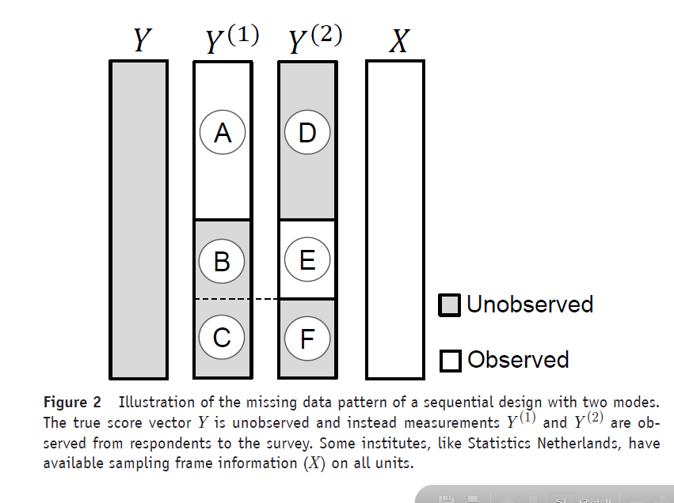
Missing data pattern (Klausch, 2016)

Slide 93
A Potential Design for Diagnosis and Estimation Effects
Build in overlap | Method 1 | Method 2
Country X | Main Data Collection | Some Data
Country Y | Some Data | Main Data Collection
Notes:
But THOMAs will tell you far more aout these issues!!!
How to get a grip on data integrity problem? Well one should have data Or to quote Holmes, data data data I cannot make brick without clay. As long as there is some overlap, as long as you have some data, you can use statistical techniques to measure the effects and try to adjust for it.

Slide 94
A Potential Design (2) for Diagnosis and Estimation Effects
Build in overlap | Method 1 e.g. f2f | Method 2 e.g. web
Wave 1 | Main Data Collection | Some Data
Wave 2 | Some Data | Main Data Collection
Notes:
But THOMAs will tell you far more aout these issues!!!
How to get a grip on data integrity problem? Well one should have data Or to quote Holmes, data data data I cannot make brick without clay. As long as there is some overlap, as long as you have some data, you can use statistical techniques to measure the effects and try to adjust for it.

Slide 95
Klausch (2014):
Basic estimation techniques for causal effects
ANCOVA estimation
Regression estimation
Propensity score weighting
Propensity score stratification
More advanced estimation techniques
Matching
Double-Robust Regression Estimation
Multiple Imputation

Slide 96
Recommended reading
Klausch, T., Schouten, B., & Hox, J. J. (2014). The Use of Within-Subject Experiments for Estimating Measurement Effects in Mixed-Mode Surveys (Discussion Paper No. 2014-06). The Hague, The Netherlands: Statistics Netherlands. Retrieved from http://www.cbs.nl/NR/rdonlyres/181793AC-94B8-4748-9C2B-E541DCF9CFB7/0/201406x10pub.pdf
Klausch, T. (2014). Informed Design of Mixed-Mode Surveys: Evaluating Mode Effects on Measurement and Selection Error (Unpublished PhD Thesis). Utrecht University: Utrecht, The Netherlands.
Schouten, B., van den Brakel, J., Buelens, B., van der Laan, J., & Klausch, T. (2013). Disentangling mode-specific selection and measurement bias in social surveys. Social Science Research, 42(6), 1555–1570.
Vannieuwenhuyze, J., & Loosveldt, G. (2013). Evaluating Relative Mode Effects in Mixed-Mode Surveys: Three Methods to Disentangle Selection and Measurement Effects. Sociological Methods & Research, 42(1), 82–104.

Slide 97
More Recommended reading
Buelens, B., & Brakel, J. A. van den. (2014). Measurement Error Calibration in Mixedmode Sample Surveys. Sociological Methods & Research.
Klausch, T., Hox, J. J., & Schouten, B. (2013). Measurement Effects of Survey Mode on the Equivalence of Attitudinal Rating Scale Questions. Sociological Methods & Research, 42(3), 227–263.
Klausch, T., Schouten, B., & Hox, J. J. (2014). The Use of Within-Subject Experiments for Estimating Measurement Effects in Mixed-Mode Surveys (Discussion Paper No. 2014-06). The Hague, The Netherlands: Statistics Netherlands. Retrieved from http://www.cbs.nl/NR/rdonlyres/181793AC-94B8-4748-9C2BE541DCF9CFB7/
0/201406x10pub.pdf
Kolenikov, S., & Kennedy, C. (2014). Evaluating Three Approaches to Statistically Adjust for Mode Effects. Journal of Survey Statistics and Methodology, 2(2),
Vannieuwenhuyze, J., Loosveldt, G., & Molenberghs, G. (2010). A Method for Evaluating Mode Effects in Mixed-mode Surveys. Public Opinion Quarterly, 74(5), 1027 –1045.
Vannieuwenhuyze, J., Loosveldt, G., & Molenberghs, G. (2014). Evaluating Mode Effects in Mixed-Mode Survey Data

Slide 98
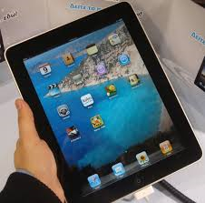
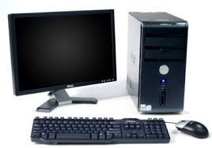
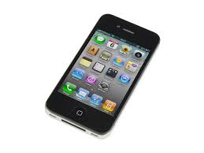
9. Mixed-device surveys
Skip to: end

Slide 99
Design for mixed-device
Respondents can access surveys with a variety of devices: optimal experience for any screen size.
There are several ways to structure surveys:
Device agnostic
same survey on all devices.
Device adaptive
longer survey on large screens, shorter survey on smaller screens.
Mobile-specific
for those studies that require in-the-moment responses.

Slide 100
Design for mobile
Questionnaires should be mobile friendly
If it fits a mobile screen, it fits any other screen
Adaptive survey design to
Small screen
Touchscreen as method of navigation
Questionnaires should be short
Most questionnaires are too complex or too long for mobile completion

Slide 101
Mobile design guideliness
Short, short, short
Simple design with as few visual distractions as possible
Flat tile design
Remove images and progress bars
No grids
Pictograms as answer options or visual relief
No horizontal scrolling
No Adobe Flash
These rules should enable a quick orientation and easy navigation in an online survey irrespective of the device used
See Arn et al., MDA, 2015 special issue on mixed-device surveys

Slide 102
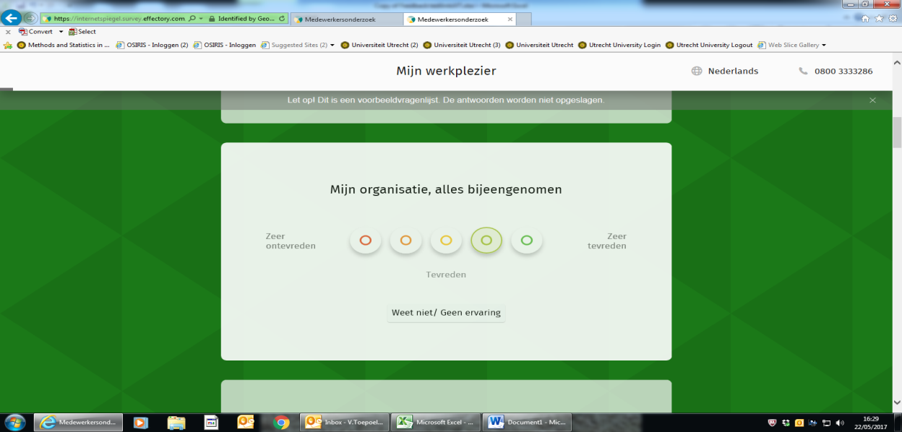
Grids: don’t or design carefully
Don’t have the answer options go off the screen
Ask the items in the grid one at a time
Keep the response options stable
Some use drag & drop (might take longer)
Accordion format (collapsable chunks)
Carousel format (items pass by)

Slide 103

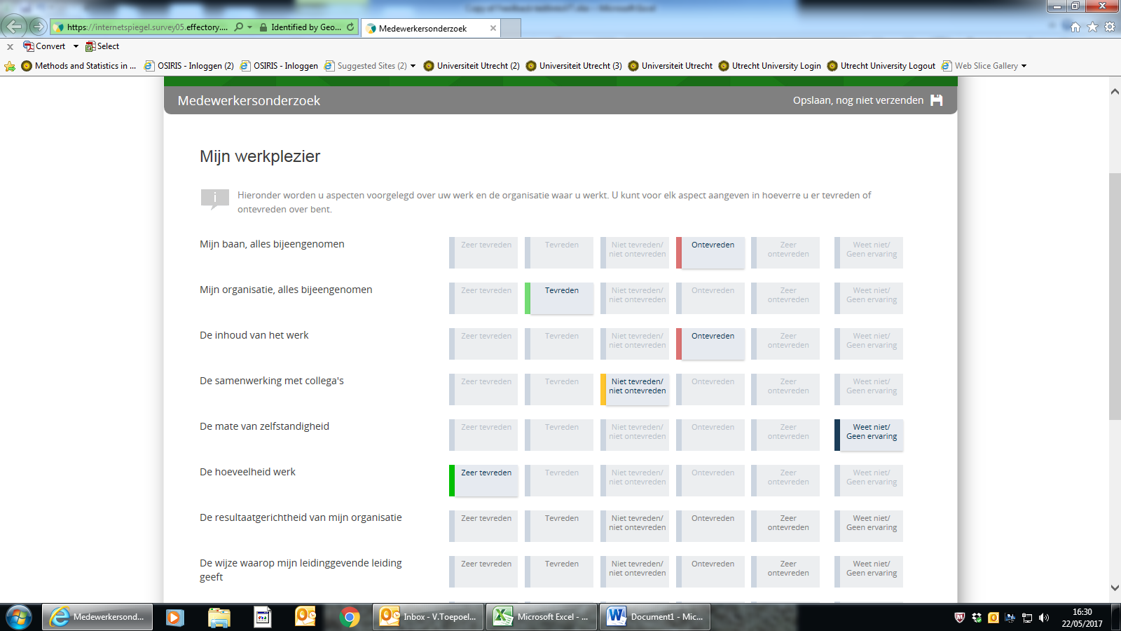
Visual relief: (vertical) accordion versus traditional grid

Slide 104
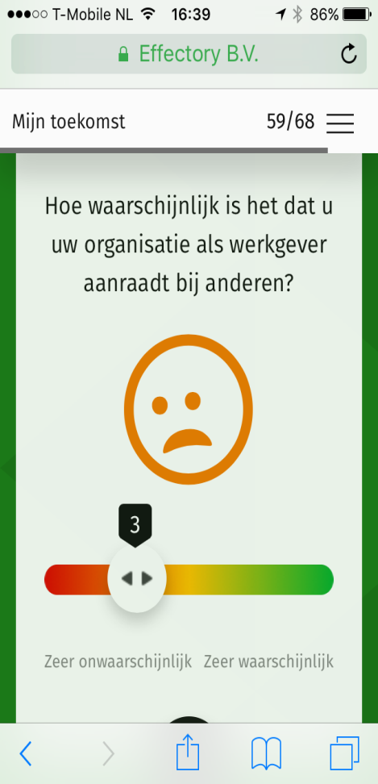
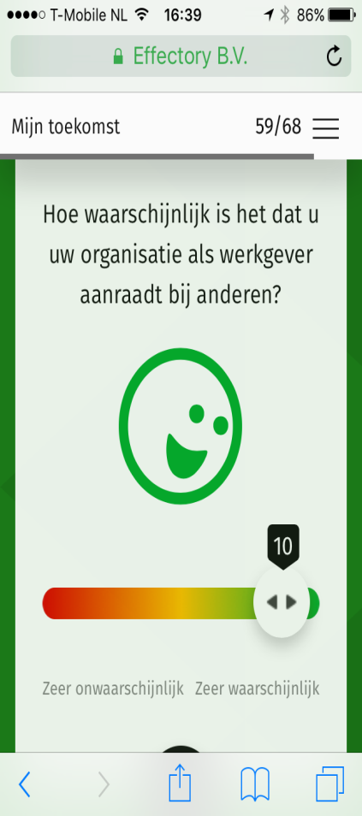
Bars
Better evaluated on mobile (see Toepoel and Funke, forthcoming)
Visual analogue scale
Point and click
versus
Slider bar
Drag and drop
Initial position handle
might influence results
- Special design

Slide 105
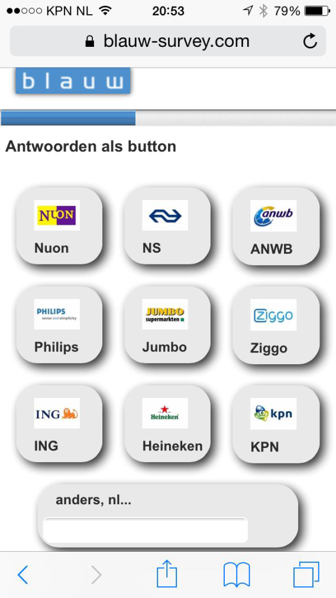
Visual, buttons, touch (no mouse)

Slide 106
Literature on optimally designing mixed-device survey
Considerable amount uses mobile (up to 25% depending on country)
Little/No effect on non-response
Little/No effect on response quality
Similar evaluation
Apps and sensors can give additional insights
Only 40% allows to use their GPS coordinates (Toepoel and Lugtig, SSCORE, 2015)
CONSENT!
No reason to believe that mixed-device is a problem WHEN DESIGNED OPTIMALLY
Able to attract hard-to-reach group such as young people (Toepoel and Lugtig, SSCORE 2015)

Slide 107
Next week
Non-probability inference
READ the literature!
Important, exercise is technical

